Slide 1
Netxpto - NetPlanner
Instruction and steps to use the software.

Slide 2
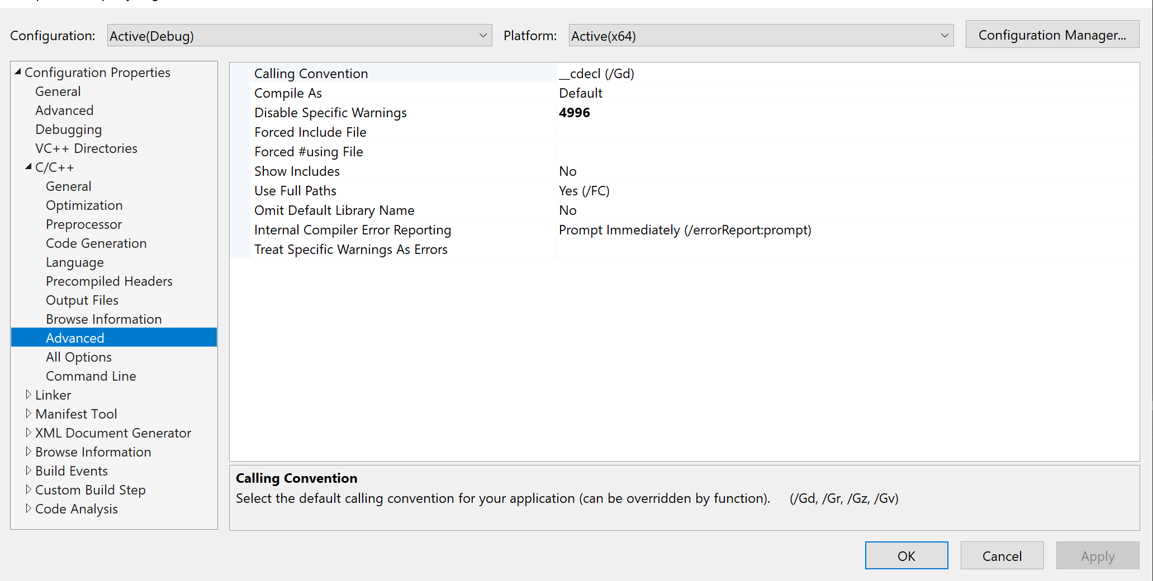
Visual Studio Setting
Since several functionalities are deprecated in the ISO C++17 Standard, the following modification is required to acknowledge it in Visual Studio:
Go to Project > “Project Name” Properties… (Shortcut: Alt + F7)
Select the Configuration Properties > C/C++ > Advanced page.
Edit the Disable Specific Warnings property to add 4996. Choose OK to apply your changes.

Slide 3
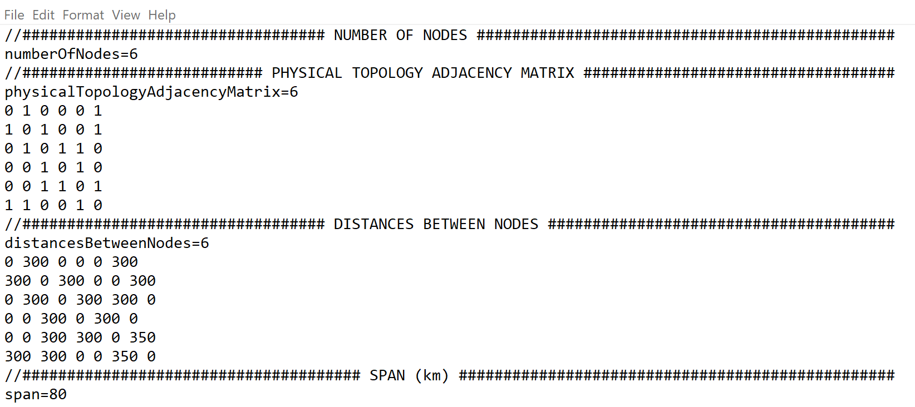
Input Parameter File
Now to pass the input parameters according to your network configurations using the “input_parameter_values.txt” file.
Change the following parameters according to your network configuration:
distancesBetweenNodes
span
odu0 to odu4
transportMode (it works for transparent only)
Parameters can be changed in the following manner:

Slide 4
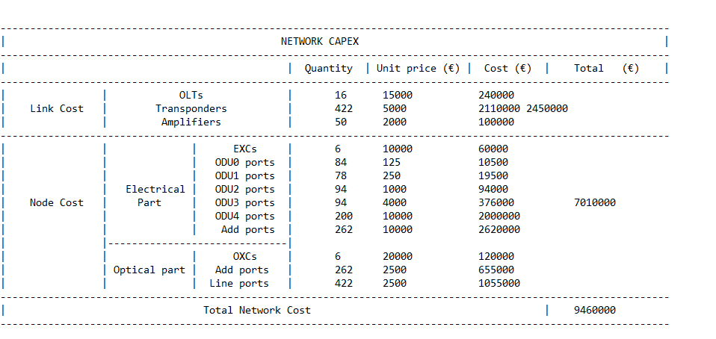
Build Solution and Run
In a similar style to the LinkPlanner project discussed earlier, build solution and run the project.
At the end “FinalReport.txt” file will be generated. Scroll down to the and check the Total Network cost value based on your network configuration as follows:

